Slide 1
IBM-AWS GenAI Techathon
2024
Name of the POC: Centralized Knowledge Repository
Authors: Satya Mullapudi, Bharathi Lella, Sanjeev Kumar, DurgaPrasad, Suhasini Arava

Slide 2
About The Gen AI POC
Prudential Retirement Services
The Centralized Knowledge Repository serves as a hub for storing and accessing critical organizational knowledge, fostering a culture of knowledge sharing and collaboration. With easy access to documents, FAQs, and best practices, teams can make informed decisions, avoid redundant work, and accelerate project timelines, ultimately improving overall operational efficiency.
Our Mapping Documents offer comprehensive documentation of data relationships between systems, ensuring smooth integration and migration processes. By identifying dependencies and potential pitfalls beforehand, our system minimizes the risk of costly delays or disruptions during project execution, optimizing resource allocation and project outcomes.
Networking Connect streamlines communication and collaboration among team members by centralizing access to contact details and application support information.

Slide 3
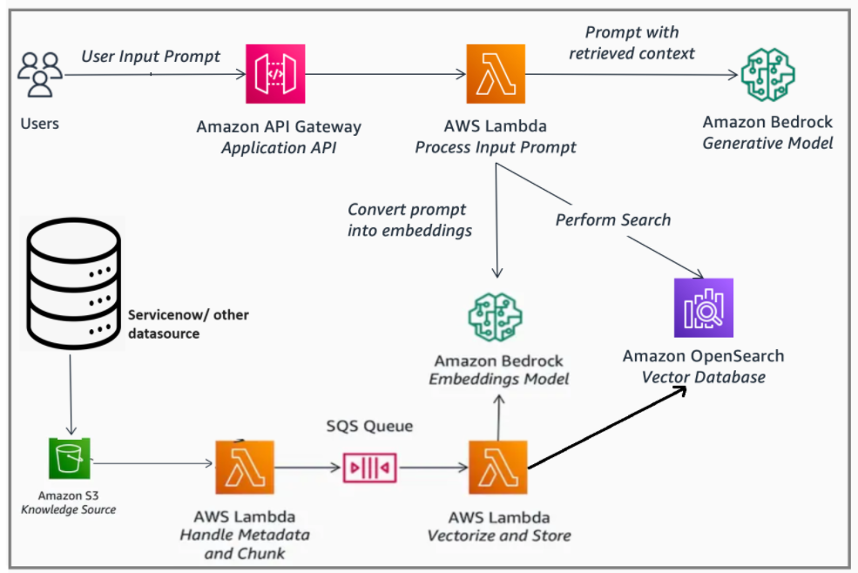
Architectural Diagram

Slide 4
AWS Services Used
Name of the AWS Service | Purpose
Amazon API Gateway | Provides developers with tools to create, manage, and secure APIs, allowing seamless integration with backend services and enabling the development of scalable applications.
AWS Lambda | Runs code in response to events without managing servers, facilitating serverless application development and enabling efficient, scalable, and cost-effective execution of code.
Amazon Bedrock | Amazon Bedrock is a fully managed service that offers a choice of high-performing foundation models (FMs) from leading AI companies like AI21 Labs, Anthropic, Cohere, Meta, Mistral AI, Stability AI, and Amazon via a single API
Amazon Simple Storage Service (S3) | Offers scalable object storage for data backup, archival, and analytics, providing durable and highly available storage infrastructure.
Amazon Simple Queue Service (SQS) | Provides fully managed message queuing for distributed applications, allowing decoupling of components and enabling asynchronous communication between them.
Amazon OpenSearch Service | Amazon OpenSearch Service is an AWS-managed service that lets you run and scale OpenSearch clusters without having to worry about managing, monitoring, and maintaining your infrastructure, or having to build in-depth expertise in operating OpenSearch clusters.

Slide 5
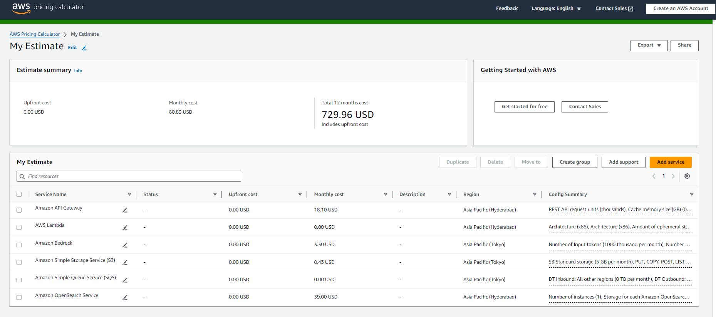
Cost of POC

Slide 6
Impact
How the POC impacts IBM/Customer And Benefits across other customers as follows.
Enhanced Customer Experience:
The Centralized Knowledge Repository serves as a hub for storing and accessing critical organizational knowledge, fostering a culture of knowledge sharing and collaboration.
Mapping Documents provide comprehensive documentation of data relationships between systems, ensuring smooth integration and migration processes.
Our system features a comprehensive access details document, illustrating required access and providing replicable examples for seamless onboarding.
Cost Saving:
The centralized knowledge repository eliminates redundant efforts in searching for information, further saving valuable time.
Clear mapping documents reduce the time required for integration and migration projects, ensuring faster project completion and delivery.
Streamlined networking connections facilitate faster communication and problem resolution, ultimately saving time and effort.
Efficient access to relevant information significantly boosts productivity across all organizational levels.

